Slide 1
Elephant in the room
MA1 Project
Warre De Winne

Slide 2
Overview
How does a microphone work?
Building a microphone
Testing the microphone
Determining the distance between an object and the microphone

Slide 3
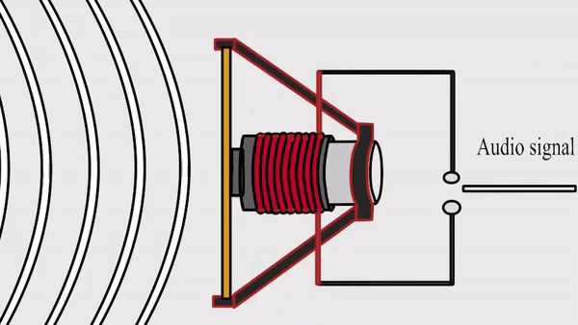
How does a microphone work?
Multiple types: condenser, dynamic, ribbon, …
Coil on membrane
Static magnet
Moving coil in magnetic field causes change in voltage across coil

Slide 4
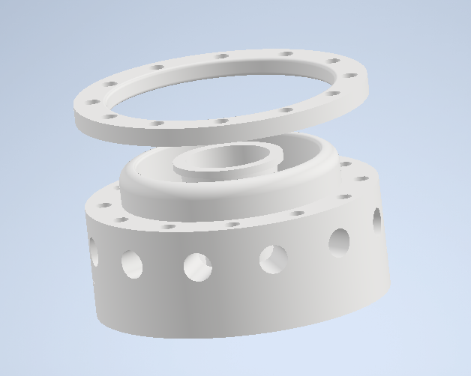
Building a microphone
3D-printed frame
Air holes at the bottom
Podium for magnets
Ring for membrane
Bearing edge
Tube for coil

Slide 5
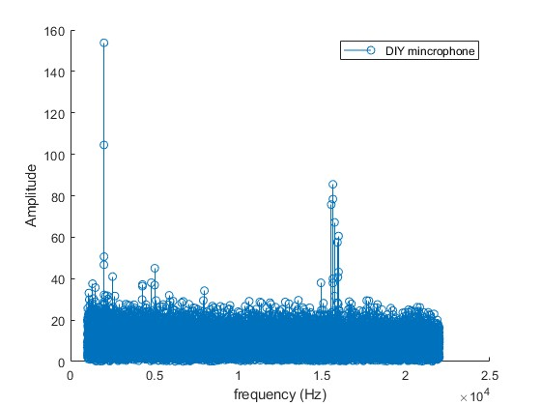
Testing the microphone
Input: 2000 Hz at 1 m
Testing if microphone receives any signal
Lots of noise
Peaks at 15k Hz
Works!

Slide 6
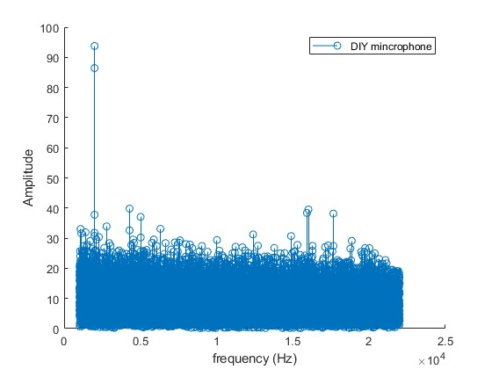
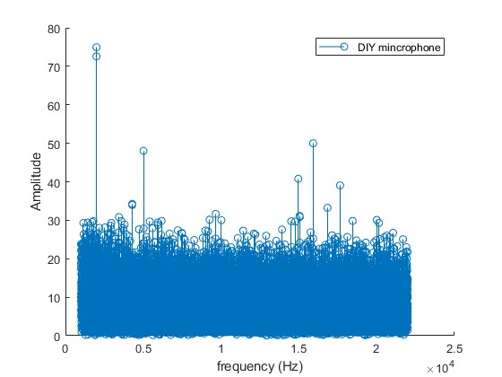
Testing the microphone
Input: 2000 Hz at 2 m
Input: 2000 Hz at 3 m

Slide 7
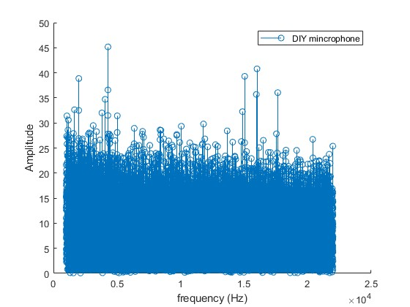
Testing the microphone
Input: 2000 Hz at 4 m
Amplitude decreases with distance
At 4 m the signal becomes too small (for 2000 Hz)

Slide 8
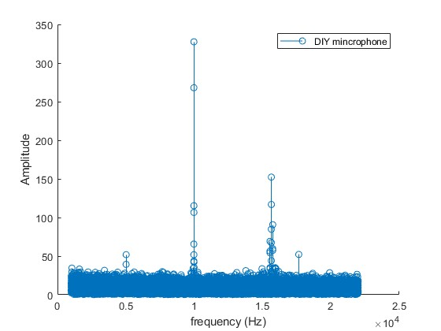
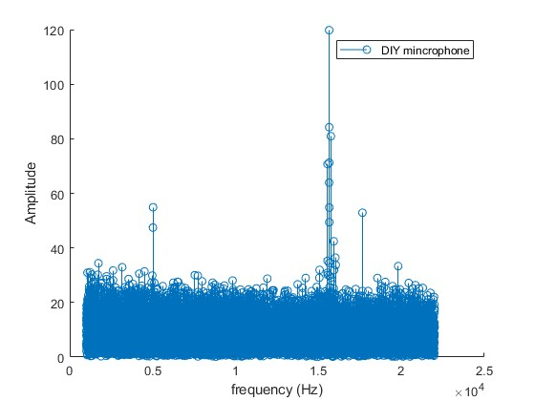
Testing the microphone
Input: 10 000 Hz at 0.4 m
Input: 15 679 Hz at 1 m

Slide 9
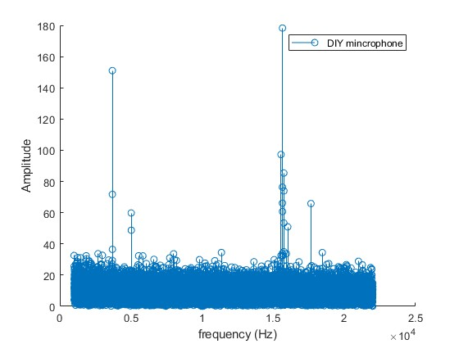
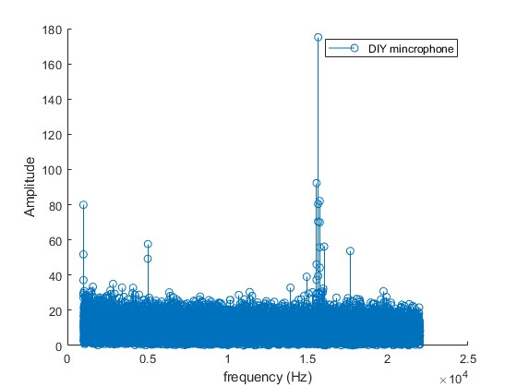
Testing the microphone
Input: 3700 Hz at 0.4 m
Input: 1000 Hz at 1 m

Slide 10
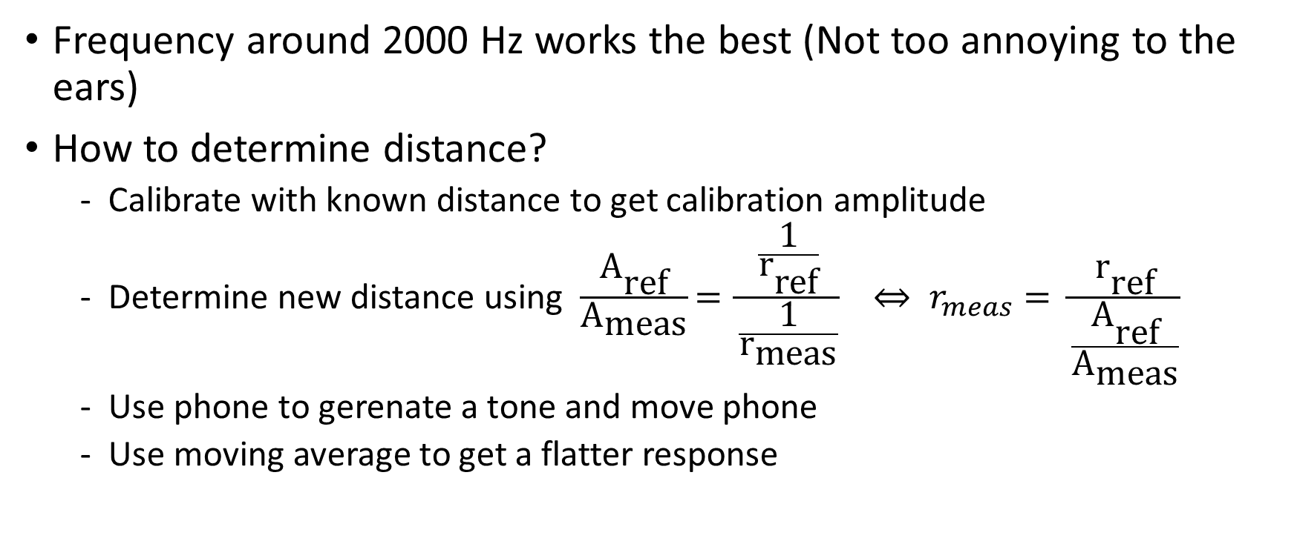
Determining the distance between an object and the microphone
Frequency around 2000 Hz works the best (Not too annoying to the ears)
How to determine distance?
Calibrate with known distance to get calibration amplitude
Determine new distance using $\frac{{\text{A}}_{\text{ref}}}{{\text{A}}_{\text{meas}}}\text{= }\frac{\frac{\text{1}}{{\text{r}}_{\text{ref}}}}{\frac{\text{1}}{{\text{r}}_{\text{meas}}}} ⇔ r_{meas}= \frac{{\text{r}}_{\text{ref}}}{\frac{{\text{A}}_{\text{ref}}}{{\text{A}}_{\text{meas}}}}$
Use phone to gerenate a tone and move phone
Use moving average to get a flatter response

Slide 11
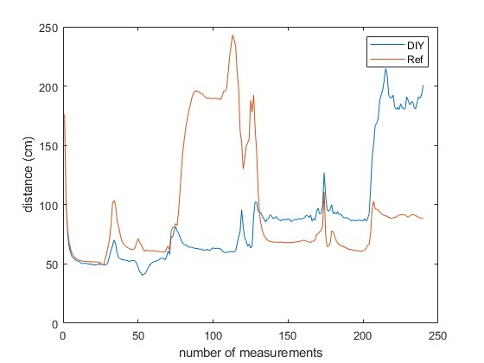
Determining the distance between an object and the microphone
50 cm
70 cm
90 cm
110 cm
130 cm
150 cm
Input: 2000 Hz

Slide 12
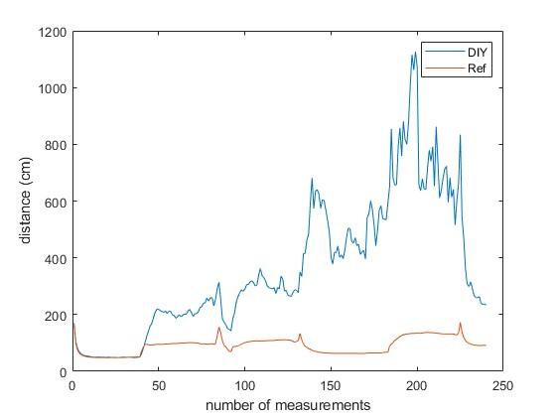
Determining the distance between an object and the microphone
Distance cannot be accurately determined
Why?
EM interference?
Interference from moving the phone?
Non-linearities in DIY microphone?
Calibrating issue?
Moving average issue?
50 cm
70 cm
90 cm
110 cm
130 cm
150 cm
Input: 10000 Hz

Slide 13
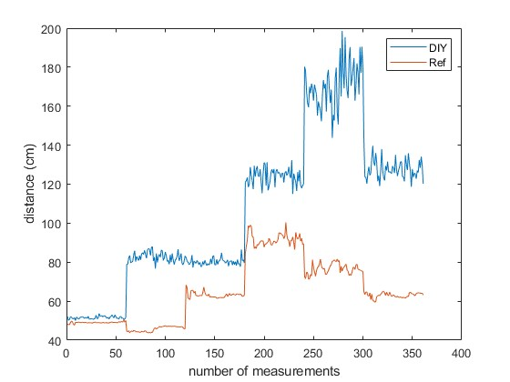
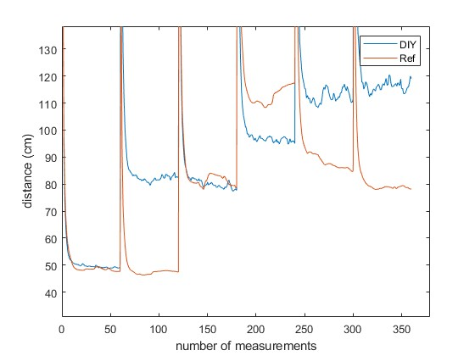
Determining the distance between an object and the microphone
50 cm
70 cm
90 cm
110 cm
130 cm
150 cm
50 cm
70 cm
90 cm
110 cm
130 cm
150 cm
Input: 2000 Hz, no weight
Input: 2000 Hz

Slide 14
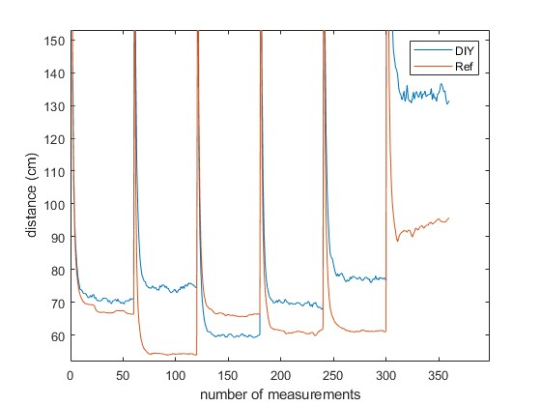
Determining the distance between an object and the microphone
Distance cannot be accurately determined
Why?
Interference from moving the phone?
Non-linearities in DIY microphone?
Calibrating issue?
Moving average issue?
70 cm
60 cm
50 cm
60 cm
70 cm
80 cm
Input: 2000 Hz

Slide 15
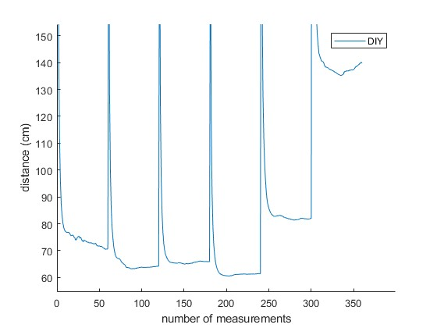
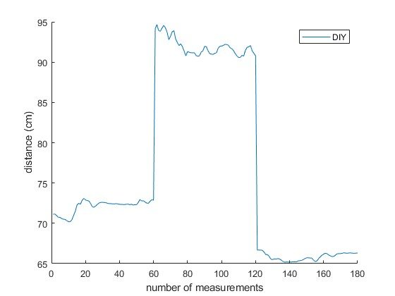
Determining the distance between an object and the microphone
0°
7°
14°
20°
25°
30°
0°
5°
-5°
Input: 2000 Hz, changing yaw
Input: 2000 Hz, changing pitch

Slide 16
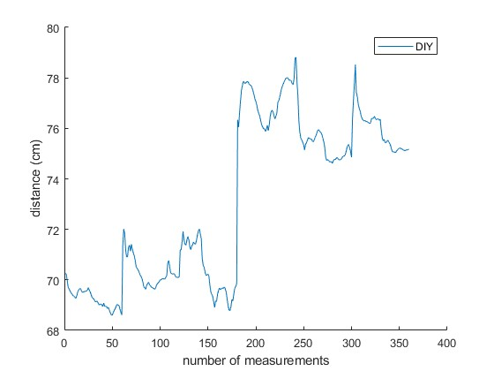
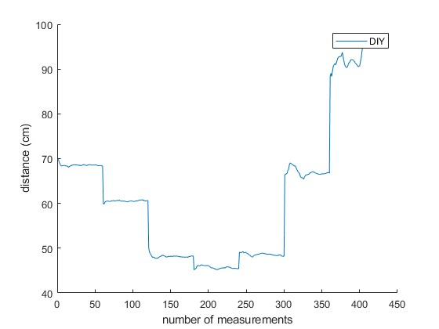
Determining the distance between an object and the microphone
0 cm
1 cm
2 cm
3 cm
4 cm
5 cm
-10 cm
-7 cm
-3 cm
0 cm
3 cm
7 cm
10 cm
Input: 2000 Hz, up/down
Input: 2000 Hz, left/right

Slide 17
Conclusion
Relative position of phone to the microphone has a huge impact
Determining distance using this method only works if the phone and microphone stay on an exact line relative to each other
Had fun doing this project
Learned a lot

